Slide 1
SCIENTIFIC
FINDINGS
Mirjam Nilsson

Slide 2
Introduction
Dr. Mirjam Nilsson holds a Ph.D. in human biology from Glenwood University
20+ years of research in the field of cell mutation
Author of “Our Bodies, Our Cells” and several research papers on DNA
Trey Research board member

Slide 3
Overview
This study focused on learning whether natural or chemical causes are more likely to cause
cell mutation.
Causes of cell mutation
Effects of exposure
Funding for future research

Slide 4
Causes of cell mutation
NATURAL
CHEMICAL
Inherited: Joint mutation via natural selection
Acquired: Chromosomal mutation
Radiation exposure
Drug treatments
Industrial toxins

Slide 5
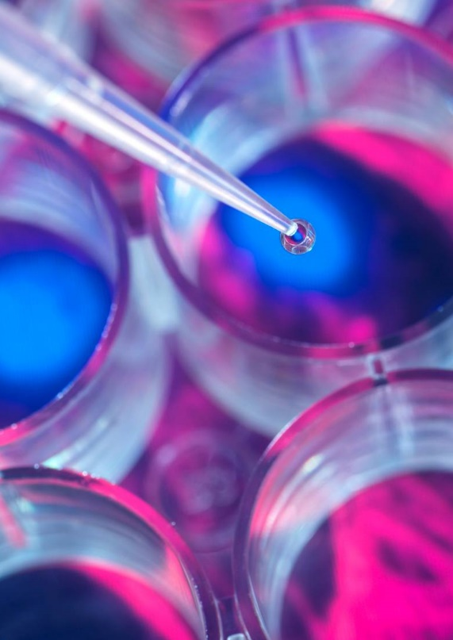
Funding for upcoming research
 | Government | Private
Cell mutations | 5,000 | 40,000
Gene therapy | 50,000 | 400,000
Drug therapy | 500,000 | 4,000,000
TOTAL | 555,000 | 4,440,000

Slide 6
Thank you
Mirjam Nilsson​
206-555-0146
mirjam@contoso.com
www.contoso.com

